Slide 1
Inventory Demand Forecasting
AIM: To build a machine learning model that predicts the optimal number of units to order(Demand) for each product by leveraging historical sales data, inventory levels, pricing, discounts, promotions, competitor pricing, seasonality, weather conditions, and external disruptions (such as epidemics).

Slide 2
Dataset
Source: Kaggle – Retail Store Inventory & Demand Forecasting
Size: 76,000 rows × 16 columns
Column | Dtype | Description
Date | object | Record date
Store ID | object | Store identifier
Product ID | object | Product identifier
Category | object | Product category
Region | object | Store region
Inventory Level | int64 | Units in stock
Units Sold | int64 | Units sold
Units Ordered | int64 | Units restocked
Price | float64 | Selling price
Discount | int64 | Discount applied (%)
Weather Condition | object | Weather (Sunny..)
Promotion | int64 | Promotion flag (0/1)
Competitor Pricing | float64 | Competitor’s price
Seasonality | object | Season
Epidemic | int64 | Epidemic flag (0/1)
Demand (Target) | int64 | Daily demand

Slide 3
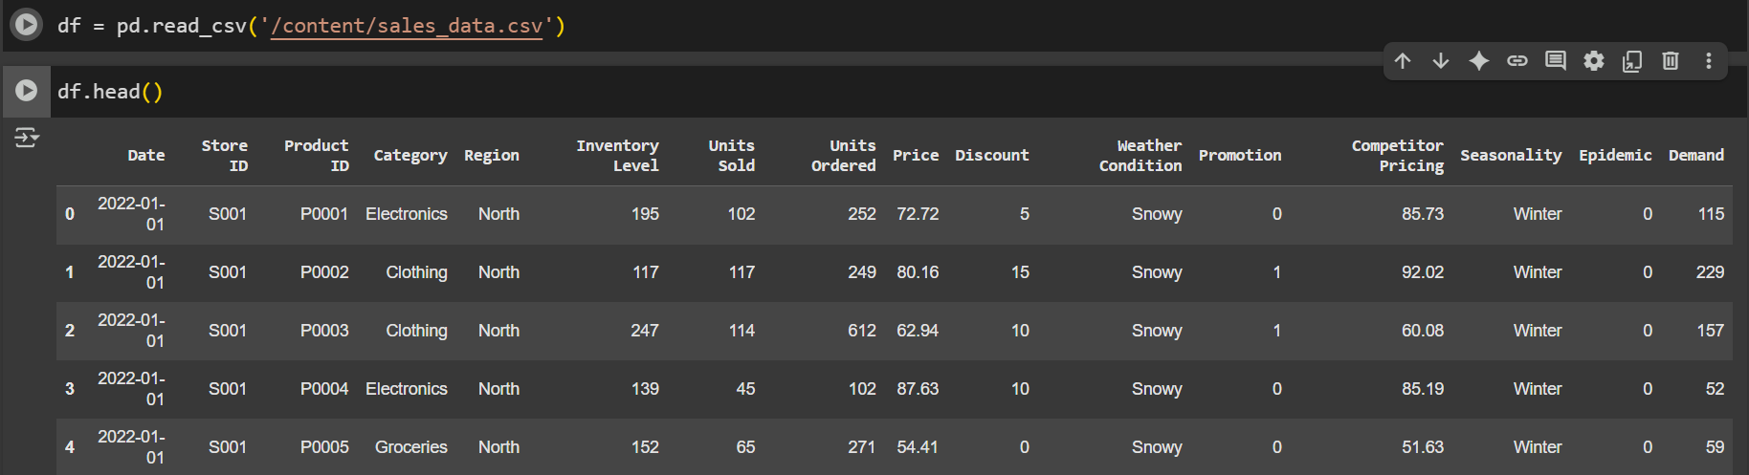
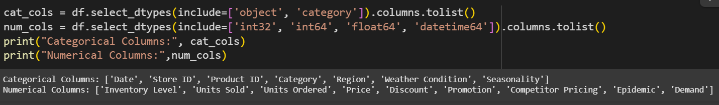
Dataset Overview

Slide 4
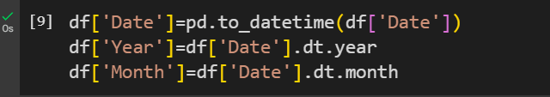
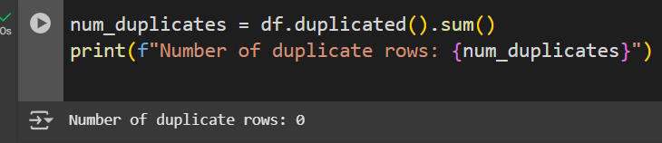
Data Preprocessing
1. To drop Store ID and Product ID because they are just identifiers and do not contribute to demand prediction
2. To convert Date into correct format and extract Year and Month for Data Analysis
3. To convert object Datatype to category because it reduces memory usage and speeds up model processing.
4. To check number of duplicate rows in dataset

Slide 5

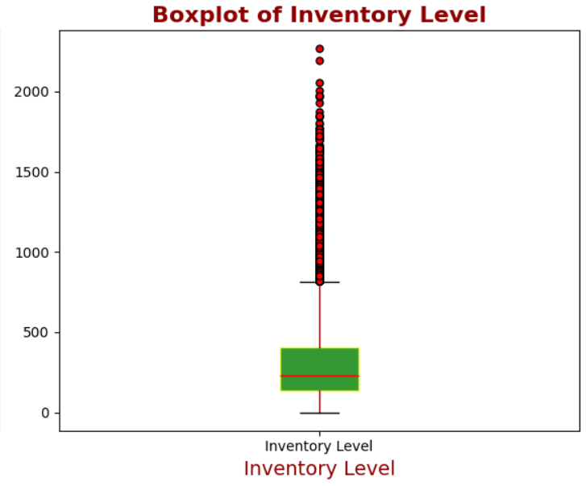
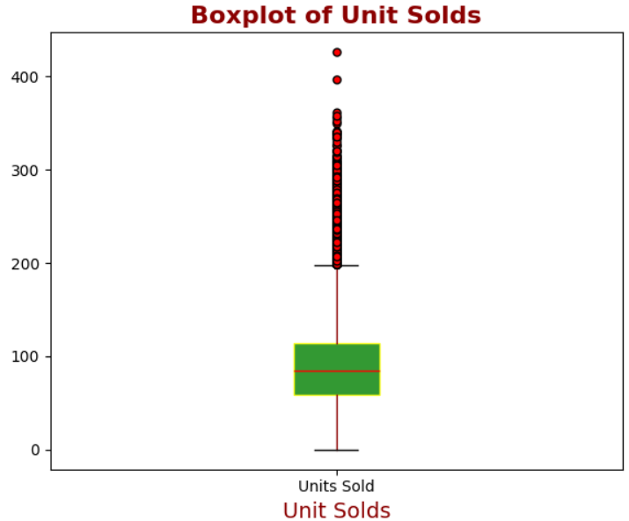
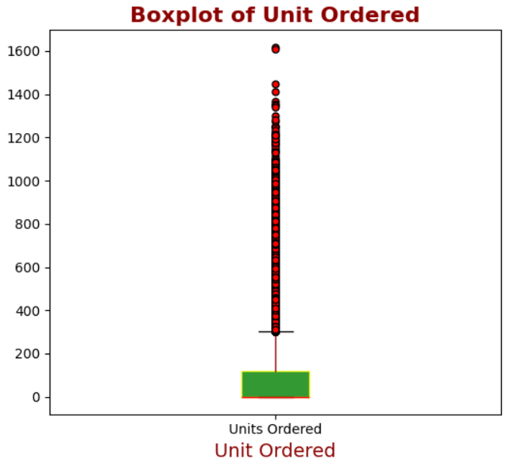
4. To check Missing values in Dataset i.e There is no Missing values in dataset (np.False)
5. Outlier Detection : Boxplots for Inventory Level, Units Ordered, and Units Sold reveal outliers, which likely reflect sudden demand surges, bulk purchasing, or data entry inconsistencies. Addressing these outliers is important for building a more reliable prediction model

Slide 6
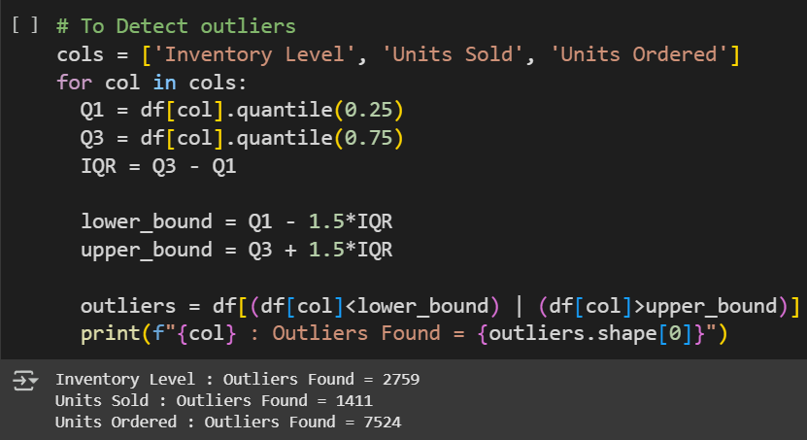
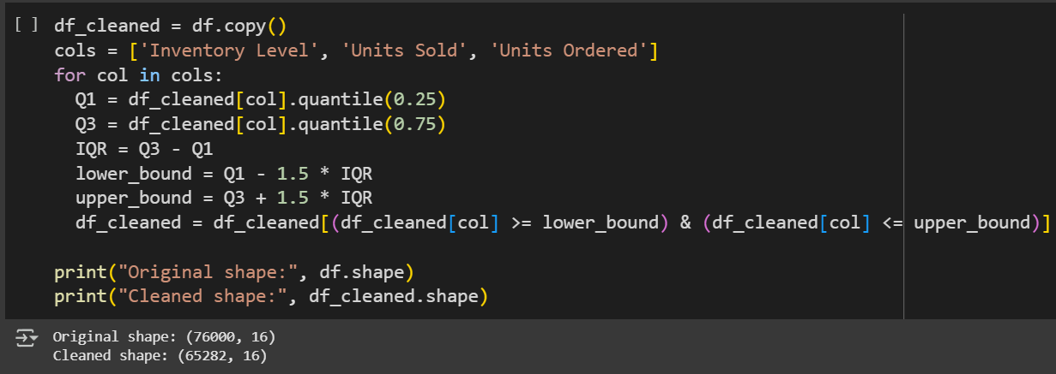
To handle Outlier : Outliers were treated using the IQR method, where extreme values beyond the lower and upper bounds (Q1–1.5×IQR, Q3+1.5×IQR) were identified and removed to maintain data quality.

Slide 7
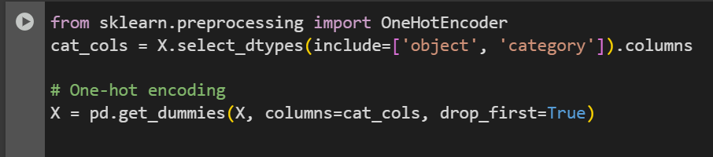
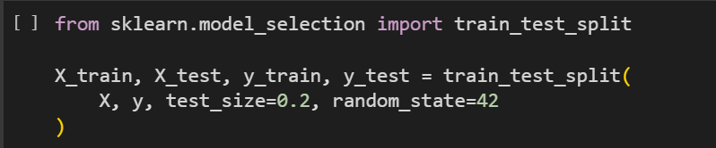
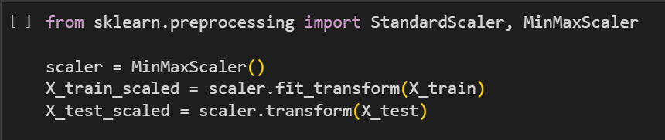
6. Encoding: Categorical columns were one-hot encoded into binary variables to prepare the data for modeling.”
7. Train-Test Split: The dataset was split into training (80%) and testing (20%) sets to evaluate model performance.”
8. Feature Scaling: Numerical features were scaled using MinMaxScaler to transform values into a 0–1 range, ensuring uniformity and improving model performance.

Slide 8
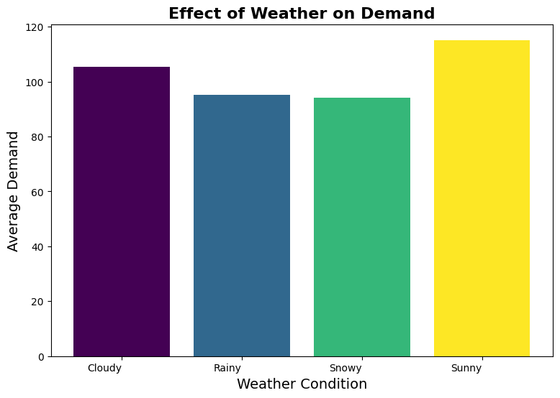

Slide 9
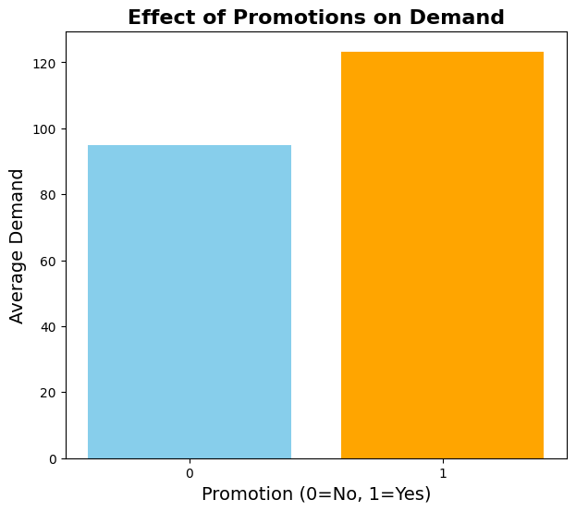

Slide 10
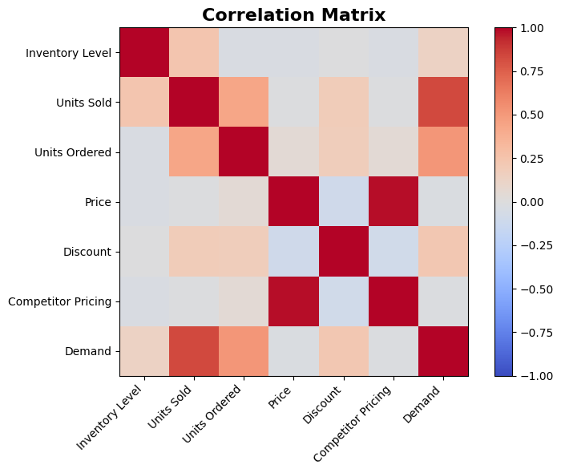

Slide 11
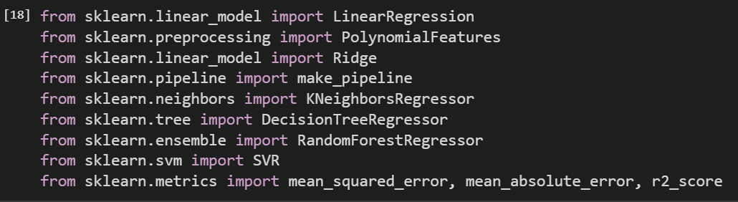
Building Model
Scikit-learn was used to implement and train all regression models, including Linear, Polynomial, KNN, Decision Tree, Random Forest, and SVR.
Mean Squared Error (MSE): Measures the average squared difference between actual and predicted values. It Penalizes larger errors more heavily; lower MSE → better model.
Mean Absolute Error(MAE): Measures the average absolute difference between actual and predicted values.
Root Mean Squared Error(RMSE) :It is used to measure the average magnitude of prediction errors in regression models.
R2 Score (Coefficient of Determination): It Represents the proportion of variance in the target explained by the model.
R² = 1 → perfect prediction (all variance explained)
R² = 1 → perfect prediction (all variance explained)
Higher R² → better model fit

Slide 12
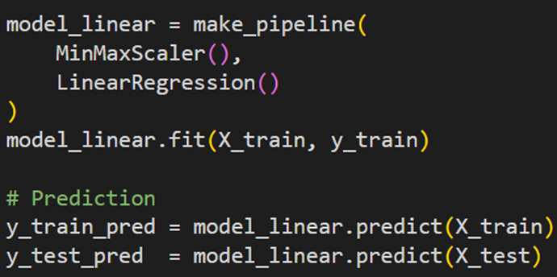
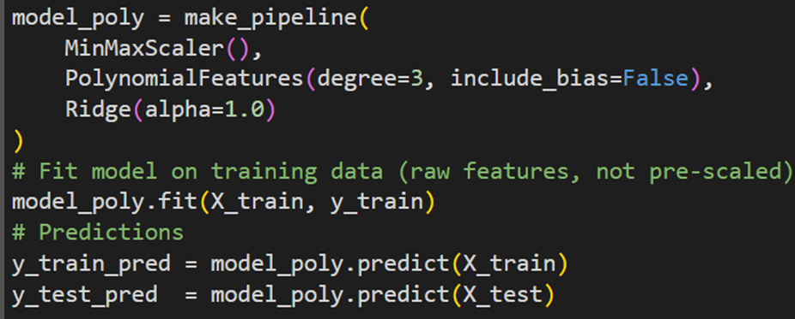
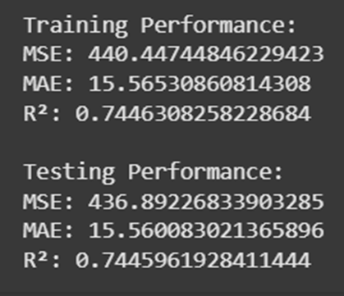
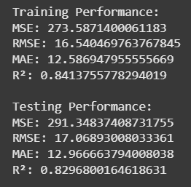
Linear Regression: It models the relationship between features and target by fitting a straight line to minimize prediction errors.
Polynomial Regression: It fits a nonlinear relationship between features and target using polynomial terms.
L2 regularization penalizes large coefficients to reduce overfitting and improve model stability.
Evaluation:
Evaluation:

Slide 13
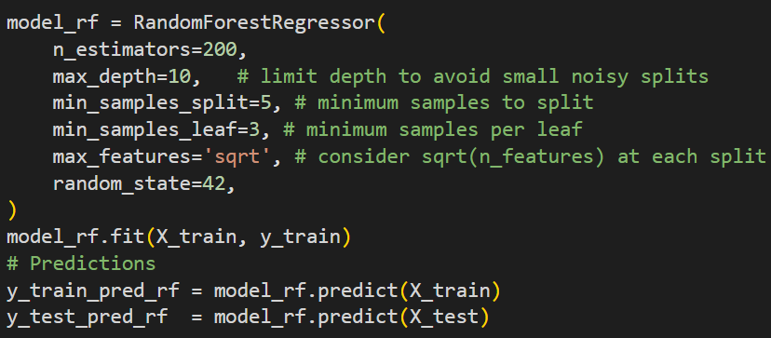
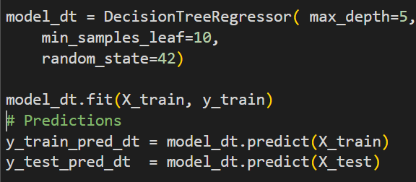
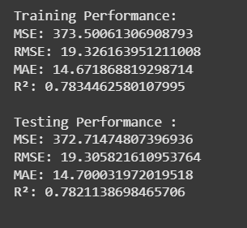
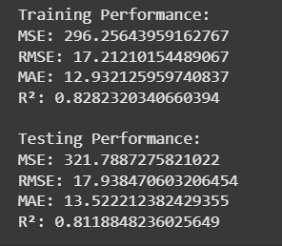
Decision Tree: splits data based on feature values to make predictions using a tree-like structure.
Random Forest: It includes multiple decision trees to improve accuracy and reduce overfitting.
Evaluation:
Evaluation:

Slide 14
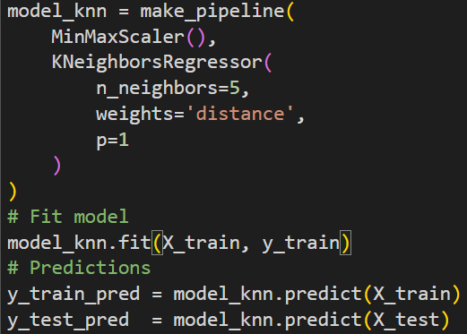
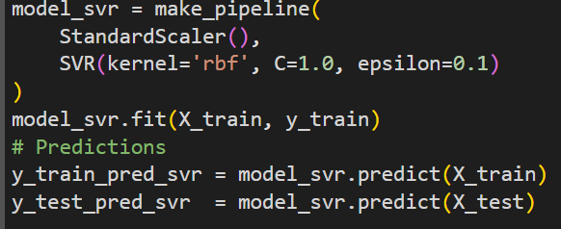
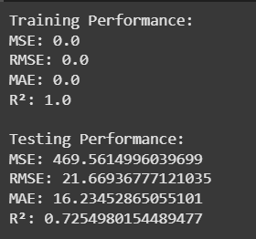
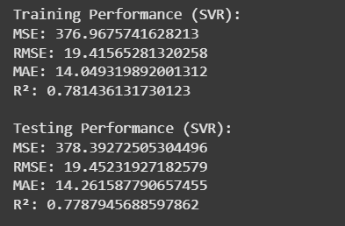
K-Nearest Neighbors (KNN): It predicts the target based on the average of the nearest data points in feature space.
Support Vector Regressor: It predicts continuous values by fitting a function within a margin of tolerance, capturing linear and nonlinear relationships using kernels.
Evaluation:
Evaluation:

Slide 15
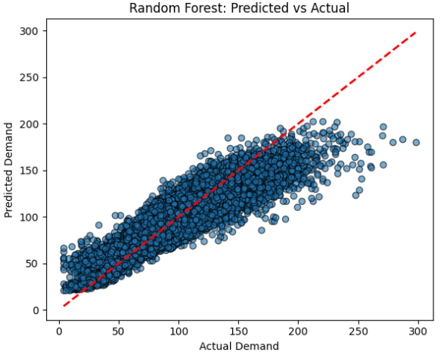
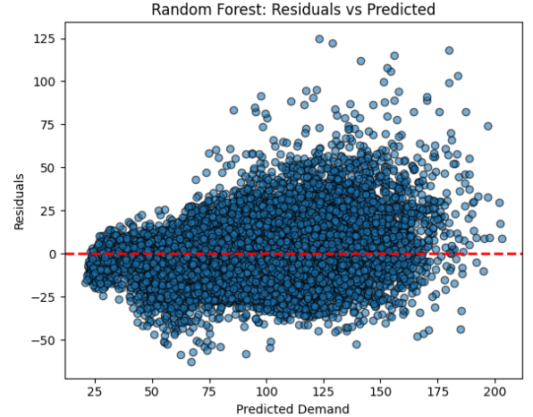
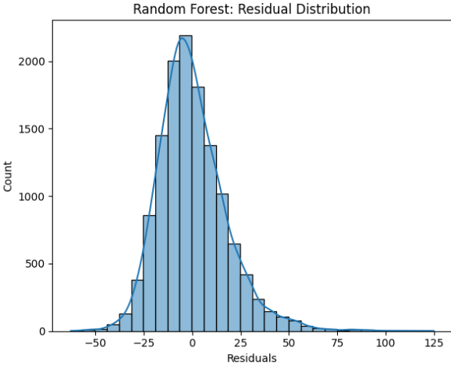

Slide 16
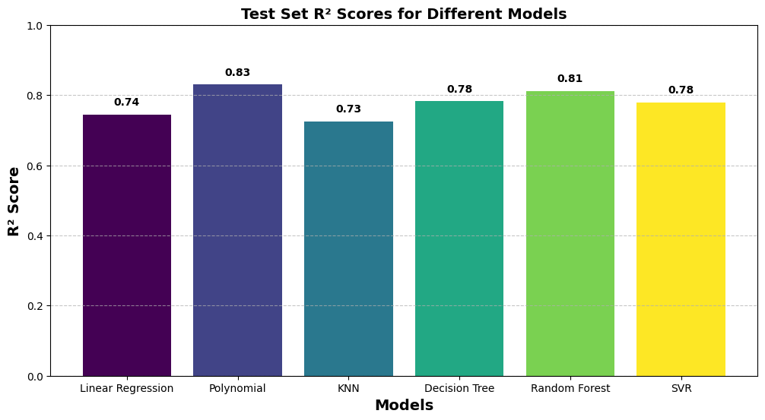
Model’s Comparison

Slide 17
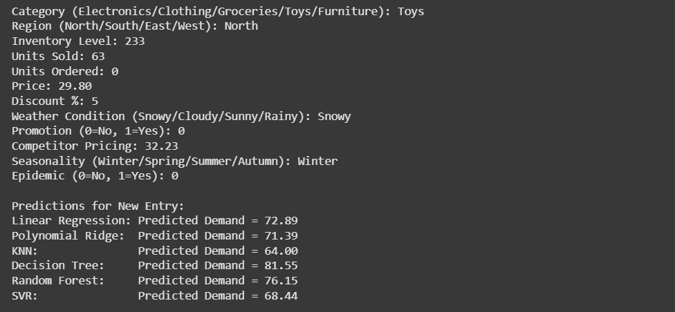
Prediction on Unseen Data
I Randomly took details from Dataset to check how well my Models predict Demand like when I enter details the demand value could be 64, But below shows how different model predict Demand value

Slide 18

Comparison of Error Percentage
Model | Predicted Demand | Actual Demand | Error %
Linear Regression | 72.89 | 64 | 13.89%
Polynomial Regression | 71.39 | 64 | 11.55%
KNN | 64.00 | 64 | 0%
Decision Tree | 81.55 | 64 | 27.42%
Random Forest | 76.15 | 64 | 18.98%
SVR | 68.44 | 64 | 6.94%

Slide 19
Findings & Insights
1. Overall Performance
All six models were trained and tested using MSE, RMSE, MAE, and R².
Performance showed variation in handling non-linearity, overfitting, and generalization.
2. Model-wise Insights
Linear Regression: Moderate accuracy (R² ≈ 0.74). Works well but limited for complex, non-linear demand.
Polynomial Ridge: Best performance (Train R² ≈ 0.84, Test R² ≈ 0.83). Captures non-linearity effectively while controlling variance.
KNN: Overfitted training data (R² = 1.0) but dropped on testing (R² ≈ 0.72) → high variance problem.
Decision Tree: Balanced but prone to overfitting (Train/Test R² ≈ 0.78).
Random Forest: Strong generalization (Train R² ≈ 0.82, Test R² ≈ 0.81). Stable and reliable across scenarios.
SVR: Performed consistently (Train/Test R² ≈ 0.78) but not as strong as Random Forest or Polynomial Ridge.
3. Error Trends
Lowest MAE: Polynomial Ridge (≈ 12.6).
Highest Overfitting: KNN (perfect train, weak test).
Best Trade-off: Random Forest (low errors + stable R²).

Slide 20
Challenges
1. Finding a Good Dataset → Real-world demand data is hard to obtain; available datasets may lack granularity or external factors.
2. Handling Outliers → Sudden demand spikes or data entry errors skew results; need robust detection & treatment.
3. Overfitting → Models like Decision Trees and KNN fit training data too well but fail on unseen data.
4. Scaling Issues → Algorithms (KNN, SVR, Polynomial Regression) are sensitive to feature scales, requiring proper normalization and finding best scaling technique ( StandardScaler(), MinMaxScaler(), RobustScaler() and many more which is perfect for my data)
5. Feature Complexity → Multiple interacting factors (price, promotions, weather, epidemics) make accurate modelling difficult.
6. External Uncertainty → Events like holidays, supply chain disruptions, or epidemics can’t always be predicted.

